Slide 1
Lecture #2 Ethics: The Fundamentals of Accountability
SPA 3541-IUP
Dept of Public Policy and Management
Fisipol
Gadjah Mada University

Slide 2
Sources of Norms
Religions
Courtesy
Social custom
Laws
Ethics

Slide 3
Why Ethics?
Ethics are by all means universal.
”Ethics in practice” is the principle that determines a nation’s progress, wealth and prosperity.
Government ethics would guide to economic, social and cultural well being.
A breach in ethical codes would generally implies a breach in various kinds of norms.

Slide 4
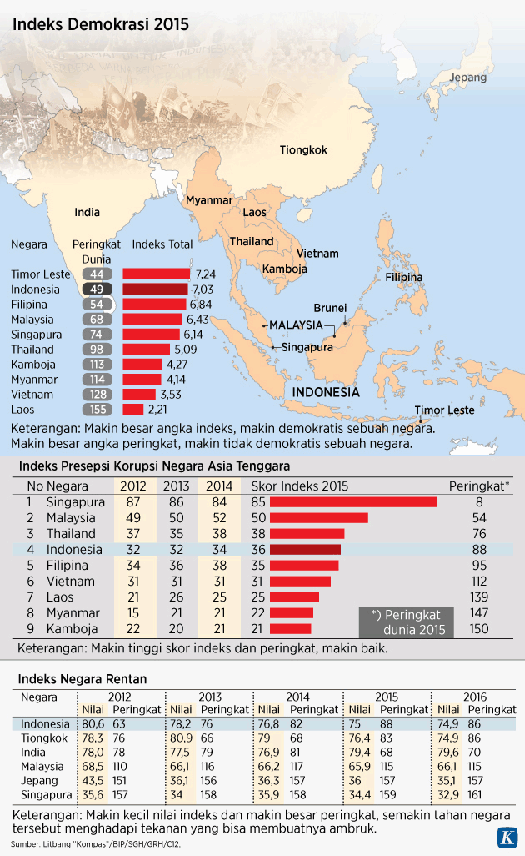
Indeks Persepsi Korupsi Masih Rendah

Slide 5
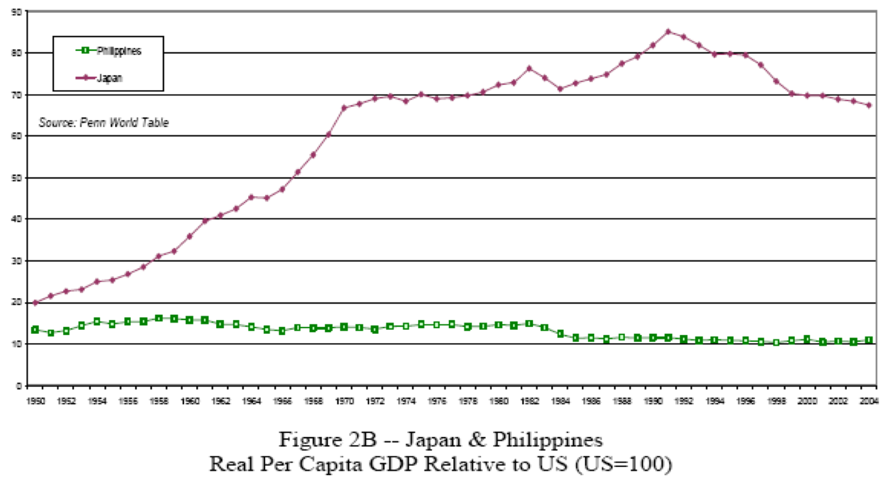
Economic Prosperity
Japan vs. Philippines

Slide 6
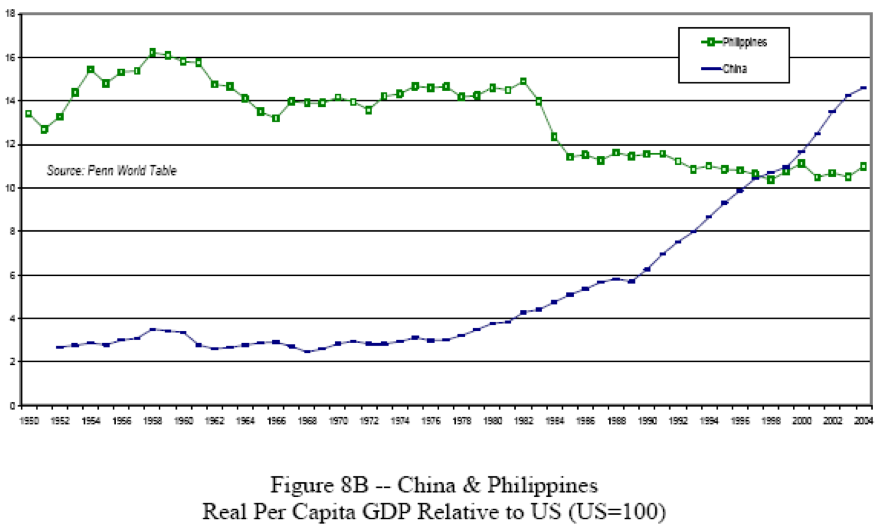
Philippines vs. China

Slide 7
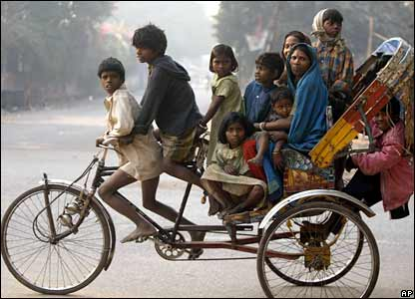
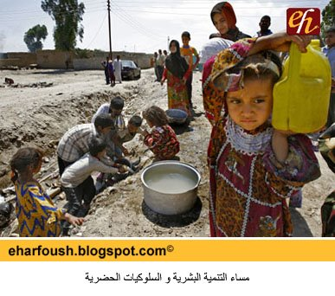
A nation progress..
is not determined by its long history.
India and Egypt, as nation states have been evolved for more than 2,000 years, but they remains backwarded, generaly poor, limited changed in living patterns.
www.reason.com

Slide 8
A nation progress..
is not determined by its long history.
Singapore, Canada, Australia & New Zealand, are only developed in the last 150 years. But currently they have proven to be among the most properous countries..
www.aviationadvertiser.co.au
www.infocomsingapore.sg
www.bcbudget.gov.bc.ca

Slide 9
Japan
www.traveltojapan.info
Japan has a limited fertile land. 80% of the area are mountains, with no potentials of strategic minerals, limited area can be cultivated.
But Japan has the second biggest economy. The lands of Japan looks like a giant indusgries; importing all natural resources from other countries, adding values on it, and exporting final products to nearly all countries. What is the secret? Ethics → work ethics.

Slide 10
SWITZERLAND
The country is very small, and only 11% of its land can be cultivated.
Switzerland does not have cacao plantations. But it turns out to be the best chocolate maker in the world. It also process top quality diary milk (with Nestle being the best brand in food industry).
Technological advance: chronometer.
Banking industry is the most trusted in the world.

Slide 11
What are the principles in developed countries?
Ethics is part of daily principles.
Trustfulness and integrity.
Responsibility
Highly appreciate regulations and laws.
5. Respect on others
6. Serious in ones’ job
7. Save and invest a lot in productive assets
8. Hard-working
9. Punctuality.

Slide 12
THANK YOU

