Slide 1
Consumer Behavior & Public Policy
Lecture #3
Microeconomics

Slide 2
Topics
Welfare economics: how understanding consumer behavior is important for making public policy.
Budget constraint and indifference curves.
Pure exchange economy: the Pareto efficiency.
The role of government: public policy.

Slide 3
Welfare Policy and Microeconomic Tools
Welfare economics is concerned with the social desirability of alternative economic states.
Distinguishes cases when private markets work well from cases where government intervention may be warranted.
Relies heavily on basic microeconomic tools, particularly consumer behaviors, indifference curves, Pareto efficiency, market failures, etc.

Slide 4
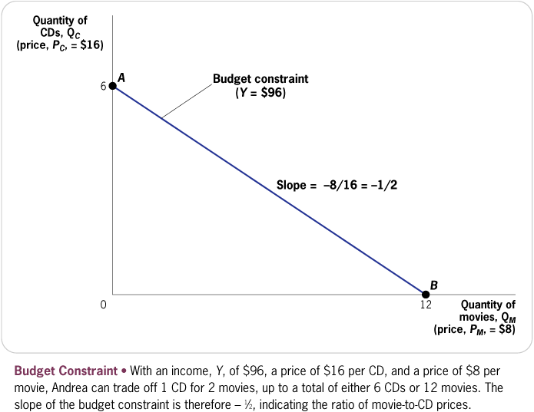
All consumers have budget constraints

Slide 5
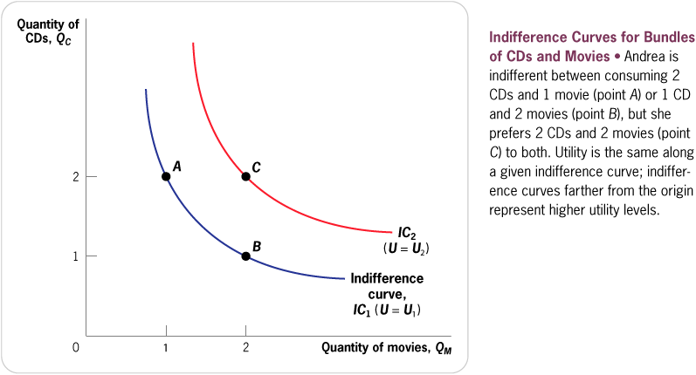
Indifference Curves

Slide 6
BL
- Budget Line
I₁ – indiference curve
good Y
I
1
Y
1
BL
X
good X
1

Slide 7
Indifference Curves of Two Consumers

Slide 8
Pure Exchange Economy
We can now pose the following question: Is it possible to reallocate apples and figs between Adam and Eve to make Adam better off, while Eve is made no worse off?
An allocation is Pareto efficient if the only way to make one person better off is to make another person worse off.
Often used as the standard for evaluating desirability of an allocation of resources.
Pareto inefficient allocations are wasteful.
A Pareto improvement is a reallocation of resources that makes one person better off without making anyone else worse off.

Slide 9
The Edgeworth Box

Slide 10
First Fundamental Theorem of Welfare Economics
Assume that
All producers and consumers act as perfect competitors (e.g., no market power)
A market exists for each and every commodity
Under these assumptions, the first fundamental theorem of welfare economics states that a Pareto efficient allocation will emerge.
Implication: Competitive economy automatically allocates resources efficiently, without central planning.
Conclusion: Free enterprise systems are amazingly productive.

Slide 11
Second Fundamental Theorem
Society can attain any Pareto-efficient allocation of resources by making a suitable assignment of initial endowments and then allowing free trade.
No adjustments to prices.
Issues of efficiency and distributional fairness can be separated.
Best market structure → Perfect competition
(1) Many, many consumers and firms
(2) Homogenous product
(3) Perfect information for buyers and sellers
(4) Free entry and exit in Long-run.

Slide 12
Issues of Public Policy: Market Failures
Externalities
Public goods
Property rights and economy of scales
Asymmetric information.

Slide 13
Externalities
There are several potential reasons that markets
fail in allocation …
Externalities
Consumption by individual or production by firm that affects utility function or production function of at least one other individual or firm:
Can be positive (utility increasing) or negative (cost increasing)
Examples: Positive - education, urban renewal, public health, R&D, etc; Negative - air pollution, noise pollution, etc.

Slide 14
Public Goods
Non-exclusive (Public) goods
A good for which, once someone buys, it everyone is able to enjoy the full amount of the services provided by the good
Examples: national defense, highways, parks, pools, golf clubs, etc.
Problem: If you can consume a good whether you pay for it or not, you have no incentive to contribute to production (the free-rider problem) which results in under-production
Solution: Government provides more efficient level of production which is financed through collection of taxes.

Slide 15
Property Rights & Economy of Scales
1. Property Rights and Enforceable Contracts
Problem: If property rights are not protected (i.e. I can steal what you produce) there is no incentive to undertake economic activity
Solution: Government regulation and enforcement.
2. Decreasing Costs/Economies of Scale
Goods for which the average cost of production decreases as quantity produced increases over a large scale
Example: Public utilities, public transportation, telecomms, etc.
Problem: Efficient production results with one (or few) large firms.
Such a market has incentive to act as monopoly which results in under-production
Solution: Government grants monopoly and regulates production to get more efficient outcome.

Slide 16
Asymmetric Information
Private/Asymmetric Information:
One party in a two-party transaction possesses more information than the other:
Firms may possess more information
Example: Product quality, drug safety/effectiveness, etc.
Individuals may possess more information
Example: Individual health, personal risk-avoidance, etc.
Problem: Party possessing more information can take advantage of other party which results in inefficient outcome
Solution: Government creates oversight bodies that regulate functioning of such markets to create more efficient outcome.

Slide 17
Final Conclusion
Public policy must be able to tackle issues on market failures.
The role of government, i.e. public policy-making, is inevitable and will never end.

